Slide 1
TEXT EXTRACTION FROM IMAGES TO ASSIST BLIND PEOPLE
UNDER THE GUIDANCE OF: TEAM: Mr T GNANA PRAKASH Suprith (14071A05J9) ASSISTANT PROFESSOR Raghu (14071A05M3) Suraj (14071A05N0) Rahul (14071A05N2)

Slide 2

Agenda
Abstract
Societal Impact
Existing System
Proposed System
System Requirements
UML Diagrams
System Architecture
Applications
Conclusion

Slide 3
Abstract
Text extraction from images is a research area which attempts to develop a computer system with the ability to automatically read the text from images. These days there is a huge demand for recognizing text from various sources which includes images and videos from natural scenes. So, we propose a camera-based assistive text reading framework to help blind persons read text labels and product packaging from hand-held objects in their daily lives.
In this method, we define the region of interest(ROI) by using text localization and recognition to acquire the text information.In this, we will enhance the efficiency of the existing optical character recognition(OCR).The challenges involved in this are , the font characteristics of the characters in images and quality of images.Due to these challenges, computer is unable to recognize the characters while reading them. Thus, there is a need of character recognition mechanisms which transforms text from images with complex background to a readable format.

Slide 4
Societal impact
We live in a society where in people are busy with their own lives.Leaving aside helping others. Our society has many handicapped individuals who depend on others for help. Our tool focuses on visually impaired by
Capturing signs boards in public places .
Capturing images from packaged goods in supermarkets etc.,
Capturing images of things in their surroundings etc.,

Slide 5
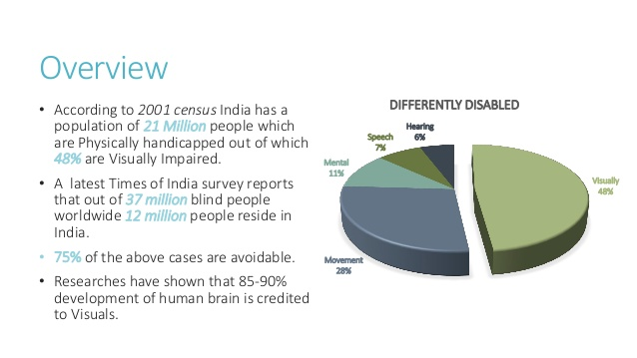
Statistics
An estimated 253 million people live with vision impairment, 37 million are completely blind and 216 million have moderate to severe vision impairment.
India is now home to the world's largest number of blind people. Of the 37 million people across the globe who are blind, over 15 million are from India.

Slide 6
Existing System
The existing OCR technique works well with simple plain images but when the same technique is applied to images which are quite complex obtained from natural sceneries, this technique fails to recognise the text present in the images.OCR works best only with good quality typed documents.No OCR software is 100 percent accurate. The number of errors depends upon the quality and type of document, including the font used. Errors that occur during OCR include misreading letters, skipping over letters that are unreadable, or mixing together text from adjacent columns or image captions. If high accuracy is required -- as with converting digital books to electronic format, then a clean-up of the electronic text will be needed.

Slide 7
Proposed System
It detects text from natural scene images and extracts them regardless of the orientation is proposed. All existing methods are designed to operate under a certain constraint, like detecting text only in one direction.We have three stages in processing an image.
Pre-processing
Segmentation
Recognition

Slide 8
Pre-processing Grayscale Noise Removal Thresholding
Segmentation Line segmentation Word segmentation Character segmentation
Recognition Feature Extraction Classifier

Slide 9
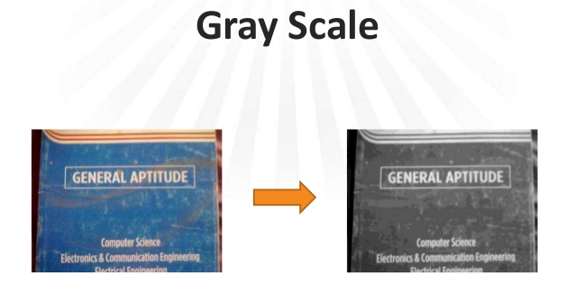
Thresholding
Edge Detection
Dilate image Detect

Slide 10
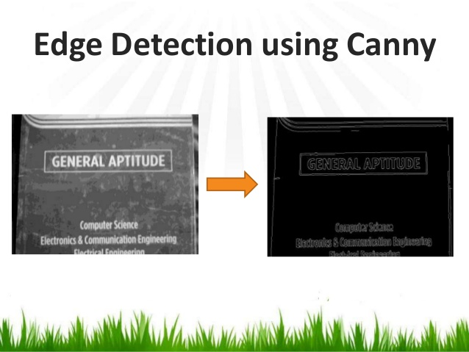
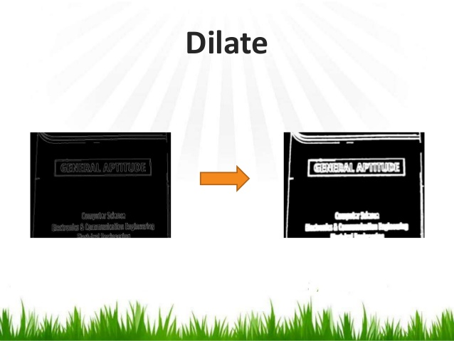

Slide 11
Feature Extraction Feature extraction is the process by which certain features of interest within an image are detected and represented for further processing.Some of the techniques are:
Binary Code Method
Chain Code Method
PCA (Principle Component Analysis)
LDA (Linear Discriminative Analysis)

Slide 12

Canny Edge Detection
Canny Edge Detection is a popular edge detection algorithm.It is a multi-stage algorithm
Noise Reduction
Finding Intensity Gradient of the Image

Slide 13
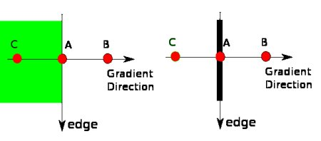
Non-maximum Suppression
Hysteresis Thresholding

Slide 14
System Requirements
Windows 7 or higher
Python IDLE
Algorithms Canny Edge Detection Median Filter SVM classifier
PIL(Python Imaging Library)

Slide 15
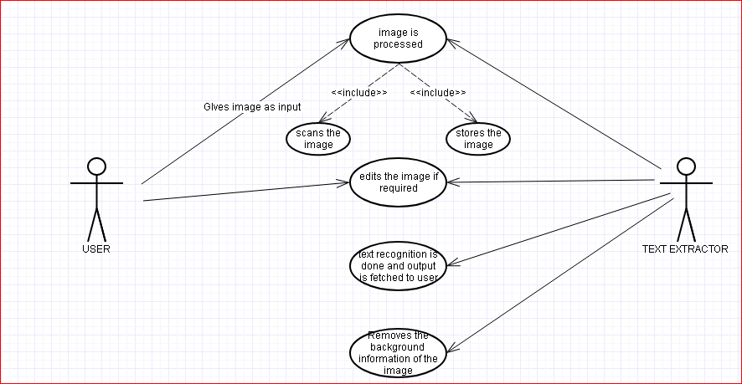
UML Diagrams
Use Case diagram

Slide 16
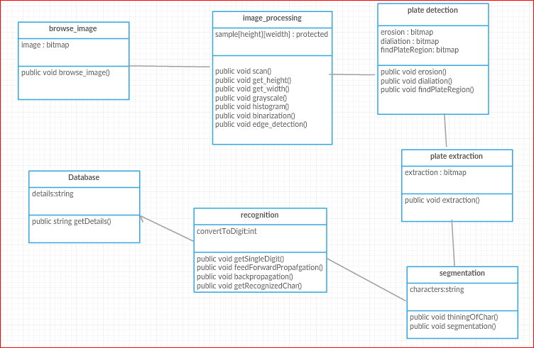
Class diagram

Slide 17
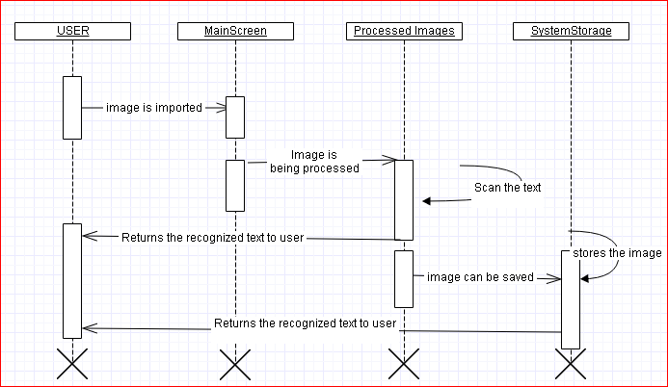
Sequence diagram

Slide 18
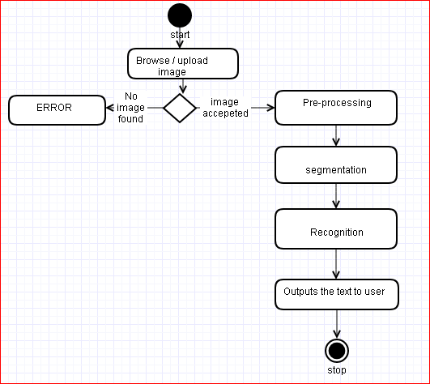
Activity diagram

Slide 19
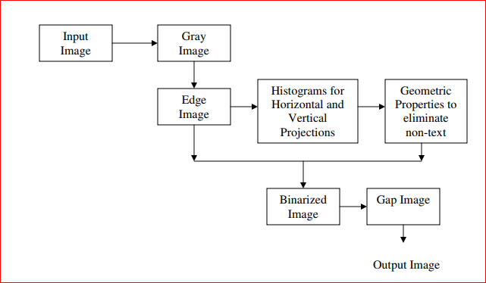
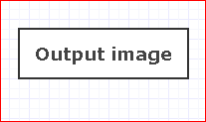
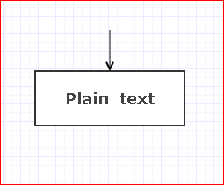
System Architecture

Slide 20
Applications
Banking (To read Credit Card)
Libraries (To detect book-id and book name)
Govt. Sector (Form Processing)
Used in Car Number Plate Recognition System
Undesirable Text removal from images.

Slide 21
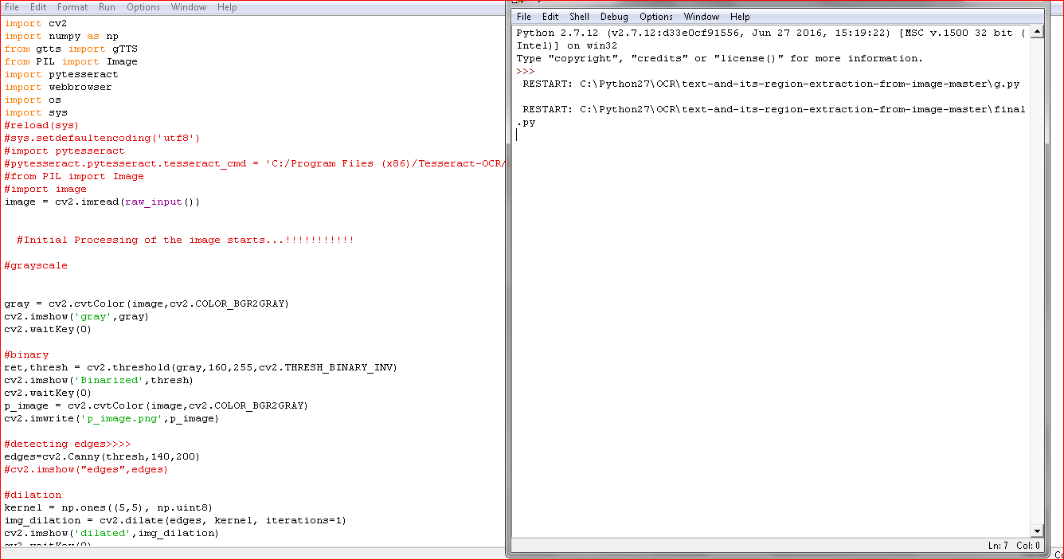
IMPLEMENTATION

Slide 22
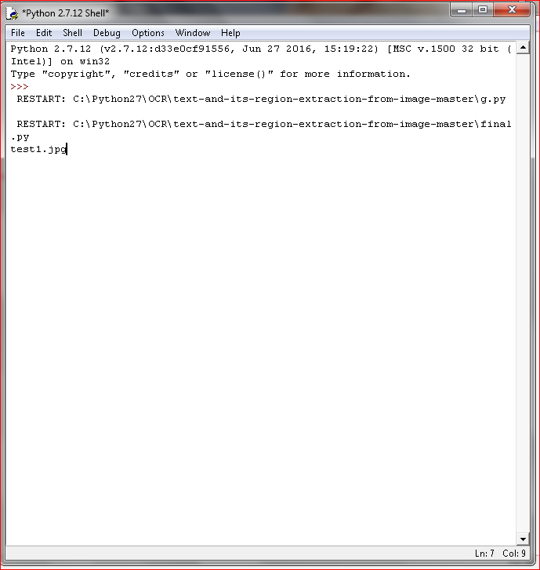
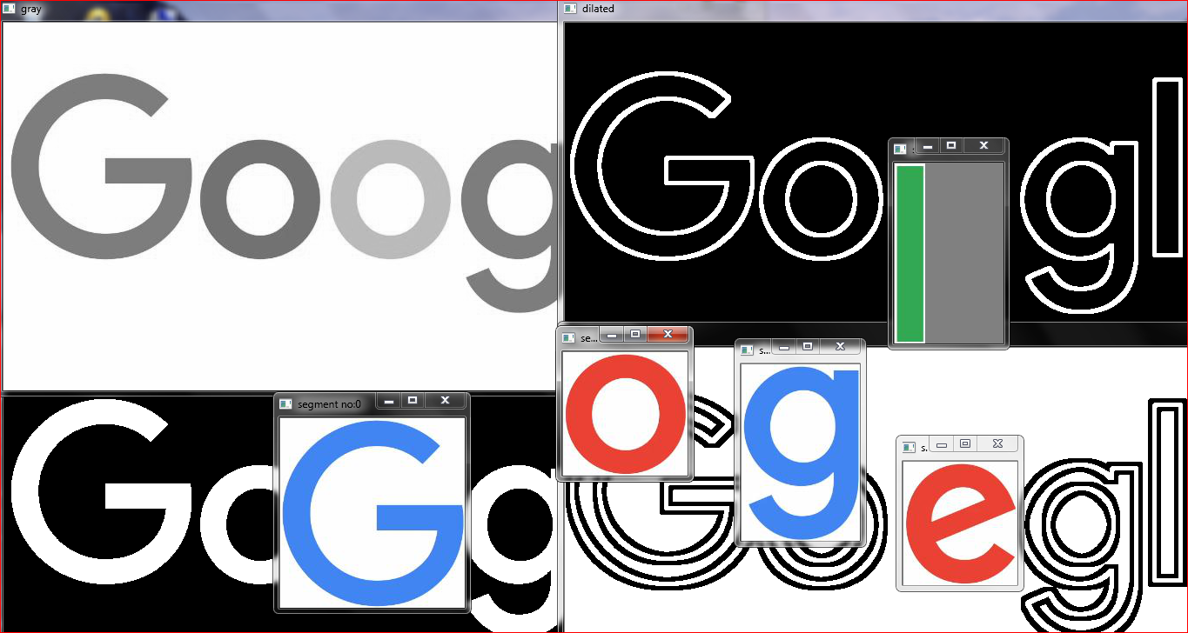
Test Case 1:

Slide 23
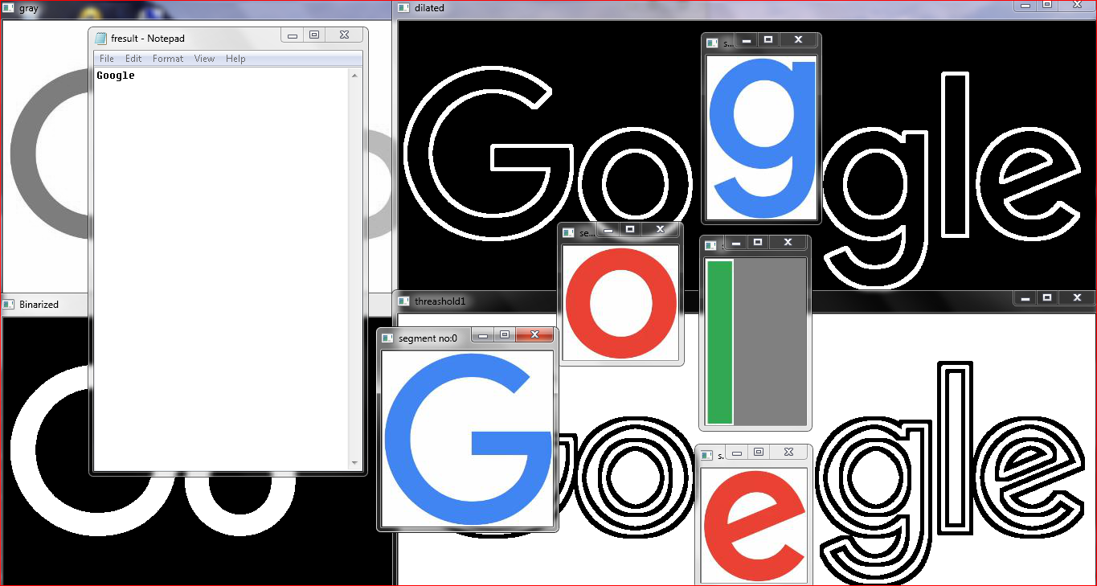

Slide 24
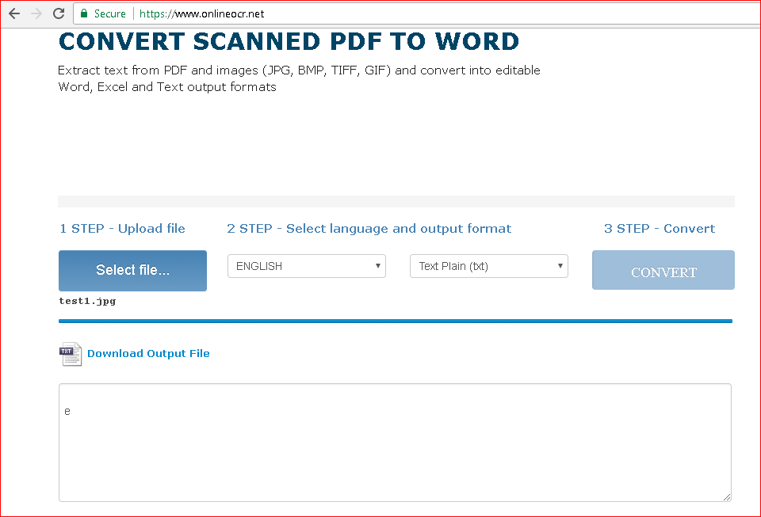
Comparison with existing OCR

Slide 25
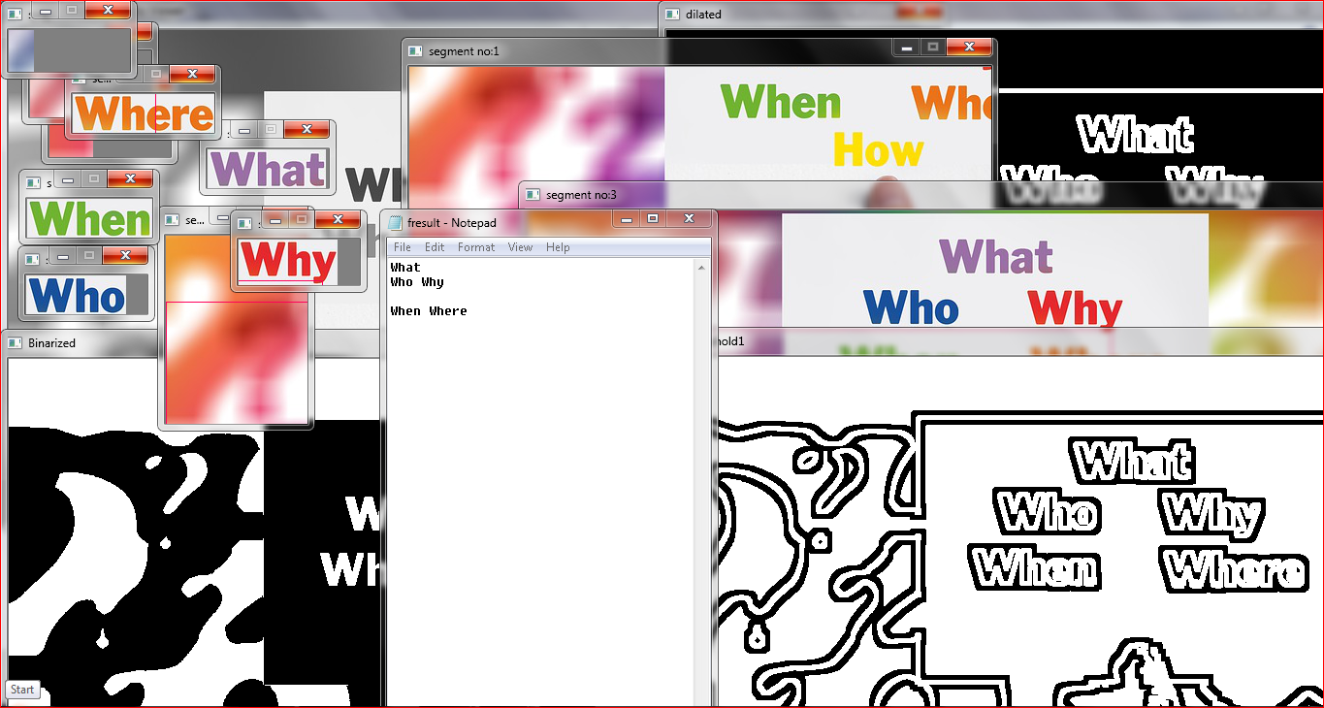
Test Case 2:

Slide 26
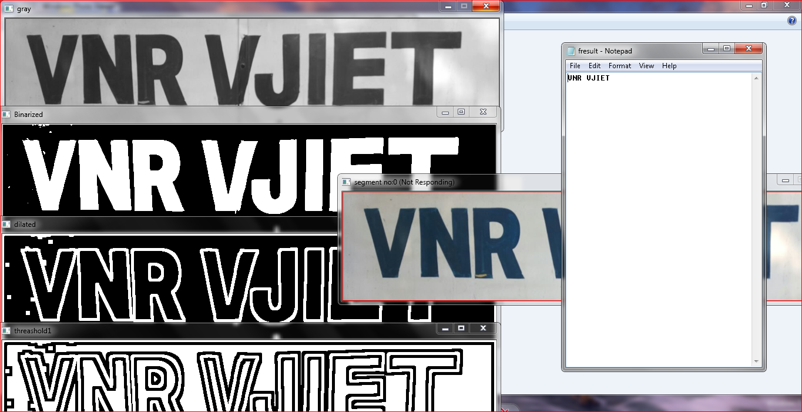
Test Case 3:

Slide 27
Conclusion
Most of the text extraction algorithm uses a direct technique where the whole image is fed to the machine and tries to extract the text from that which is not efficient because it need separate image segmentation for most of the different images. So, we are trying to do is first of all extract each text segment and then feed each segment to the separate algorithm, which will treat each segment of text as a separate image.Doing this we will get efficient output, because applying initial processing on a small segment of the image which is already processed is more accurate than applying it on a whole image.Best of all this tool can be used in association with any camera facilitated devices such as mobiles or any specialized device etc.

Slide 28
THANK YOU!!!

